Slide 1

Histopathologic
Cancer Detection

Slide 2
Introduction
Cancer is a group of diseases involving abnormal cell growth with the potential to invade or spread to other parts of the body.
Symptoms:- Lump, abnormal bleeding, prolonged cough, unexplained weight loss.
Histopathology refers to the examination of a biopsy or surgical specimen by a pathologist, after the specimen has been processed and histological sections have been placed onto glass slides.
Reference : Classification of Breast Cancer Based on Histology Image Using Convolutional Neural Networks

Slide 3








Machine Learning
NVIDIA DGX

Slide 4

Front-end

Slide 5




Back-end

Slide 6
Convolutional Neural Network

Slide 7
Dataset
Small pathology images with labels
96x96 pixels
Images 220,025
Positive label indicates center 32x32px region has some cancer tissues

Slide 8



Sample Images
Given below are some examples taken from our dataset
96px
96px

Slide 9
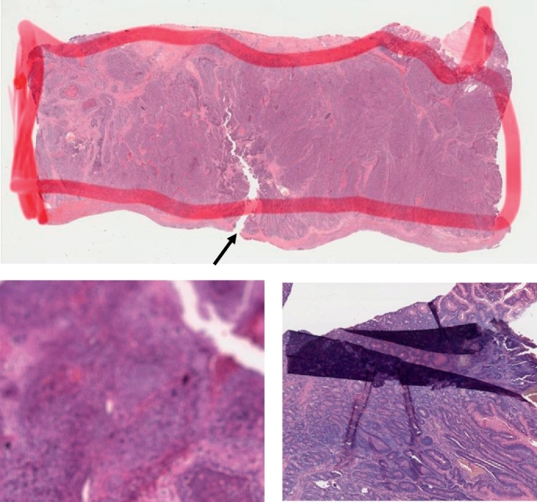
Tear formation and overlapping in tissue due to human error.

Slide 10
Preprocessing
Rescale
Scale-up
Rotation
Color change
Horizontal & Vertical flip

Slide 11




Preprocessing images
Original
Brightness
Horizontal Flip
Rotation
Vertical Flip

Slide 12
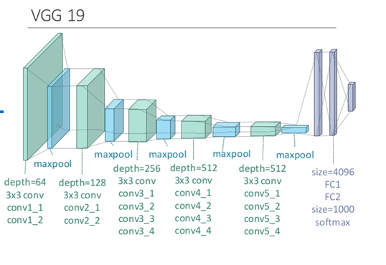
Pretrained Model

Slide 13
Timeline of the Project
DATASET PREPARE
MODEL SELECTION
STEP V
BACK-END DEVELOPMENT
STEP I
STEP III
TESTING AND DEPLOYMENT
STEP II
STEP IV
DATASET TESTING
FRONT-END DEVELOPMENT

Slide 14
Scope for this Semester
Preprocessing Dataset with various techniques
Preparing a dataset for best performance on any given deep learning model
Testing the dataset on pretrained models to cross-check the acceptability

Slide 15
Thank You!

